Slide 1
LEDs as Sensors
Paul H. Dietz, PhD
Philantic, LLC.
Redmond, WA
Ginger Alford, PhD
SMU Lyle School of Engineering
Dallas, TX

Slide 2
Prerequisites
Played with Arduino before
Made an LED blink on and off
At least a vague understanding of voltage and current
Analogies to water pressure (voltage) and flow (current)
All files are at: https://github.com/paulhdietz/LEDSensors2019

Slide 3
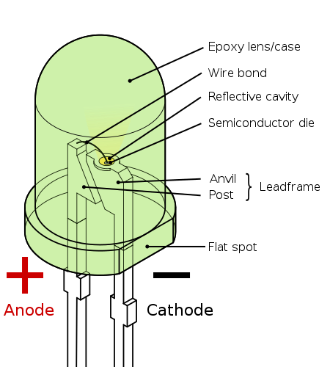
What’s an LED?
Light Emitting Diode
Emits light proportional to the forward current flow
It is a diode
(flag)
+
Anode
-
Cathode
(longer lead)
(shorter lead)
Source: https://en.wikipedia.org/wiki/Light-emitting_diode#/media/File:LED,_5mm,_green_(en).svg

Slide 4
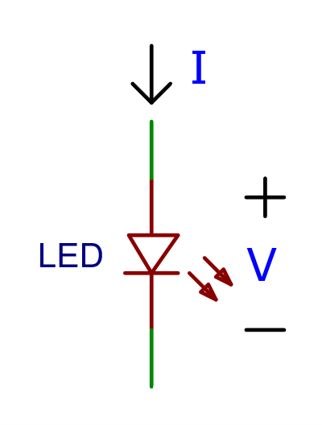
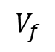
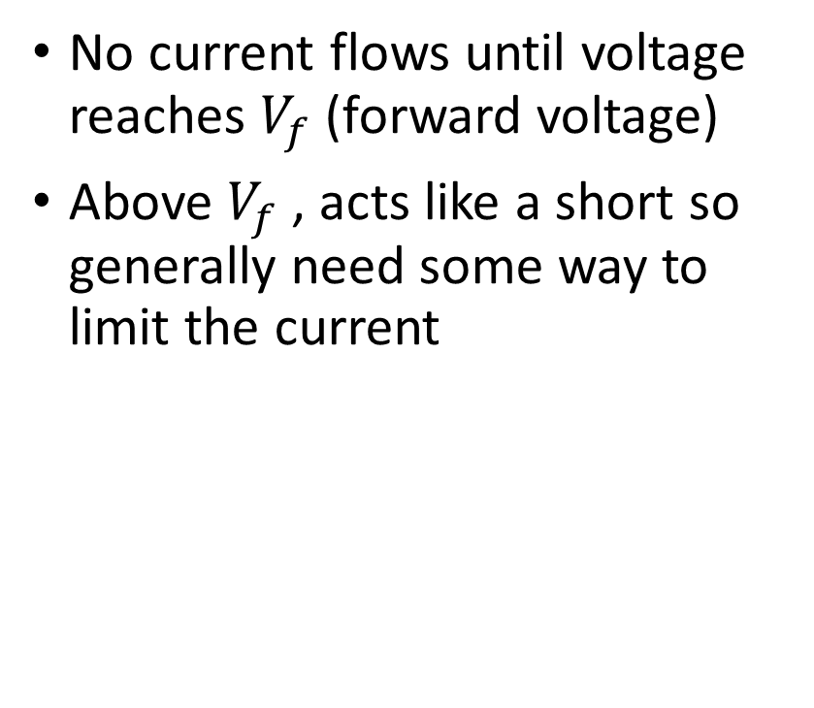
Ideal Diode Model
No current flows until voltage reaches $V_{f}$ (forward voltage)
Above $V_{f}$ , acts like a short so generally need some way to limit the current
I
$$V_{f}$$
V

Slide 5
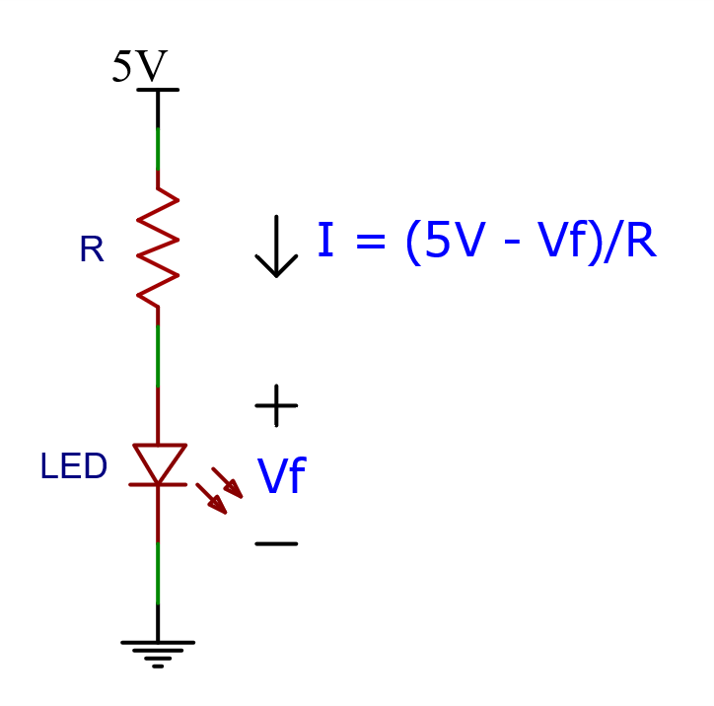
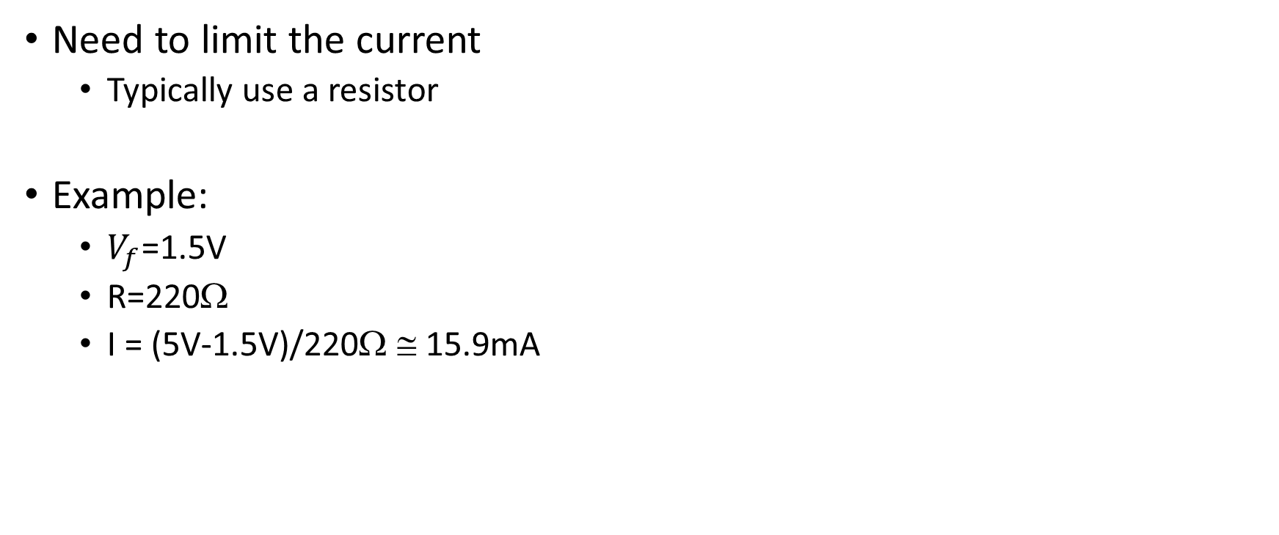
Powering an LED
Need to limit the current
Typically use a resistor
Example:
$V_{f}$=1.5V
R=220Ω
I = (5V-1.5V)/220Ω ≅ 15.9mA

Slide 6
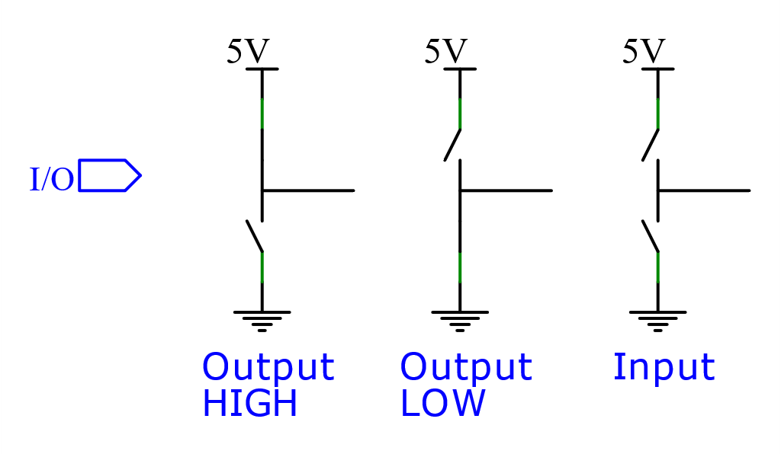
Digital I/O Pins Ideal Model

Slide 7
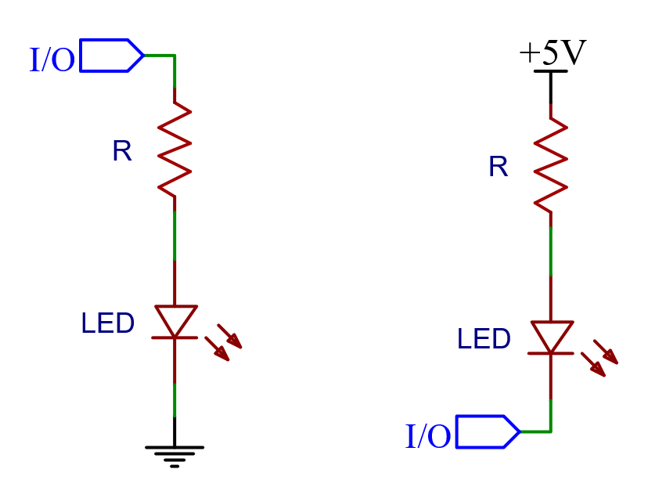
Driving an LED from the Arduino Uno
I/O pins can connect to power or ground (or neither – input)
Two ways of controlling an LED
Right is inverted (LOW is on)
Pin 13 is setup switching power to a resistor and LED on board

Slide 8
Task #1: Blink an LED
_01_Blink_Pin13_LED.ino

Slide 9
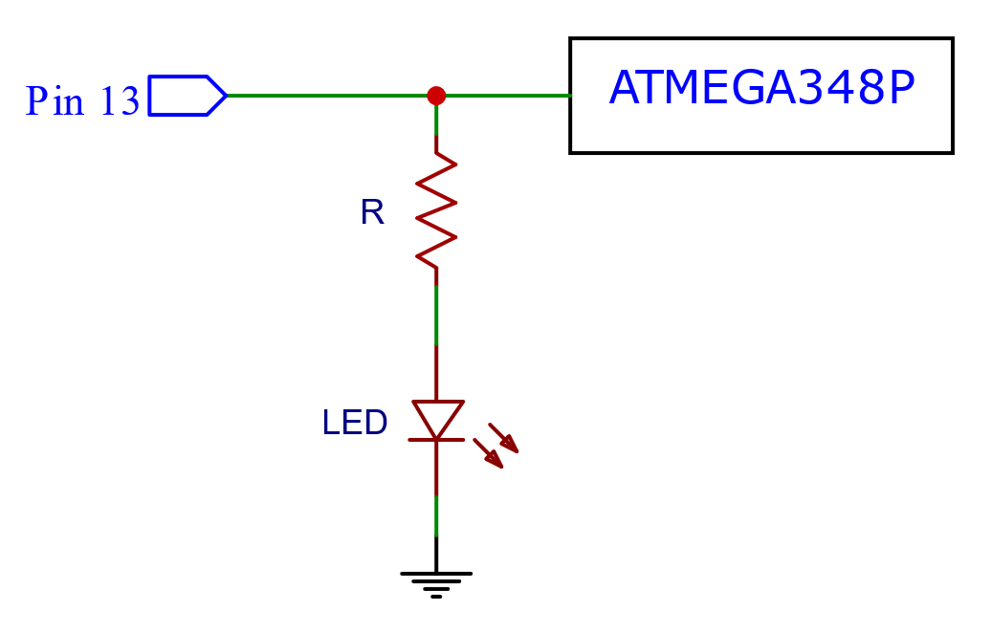
Arduino Blink (Using on-board LED)
_01_Blink_Pin13_LED.ino
// Blink Pin 13 LED
#define LED 13 // On-board LED is on Pin 13
void setup() {
// initialize digital pin LED_BUILTIN as an output.
pinMode(LED, OUTPUT);
}
void loop() {
digitalWrite(LED, HIGH); // turn the LED on (HIGH is the voltage level)
delay(250); // wait for 1/4 second
digitalWrite(LED, LOW); // turn the LED off by making the voltage LOW
delay(250); // wait for 1/4 second
}
Arduino UNO has on-board LED on Pin 13

Slide 10
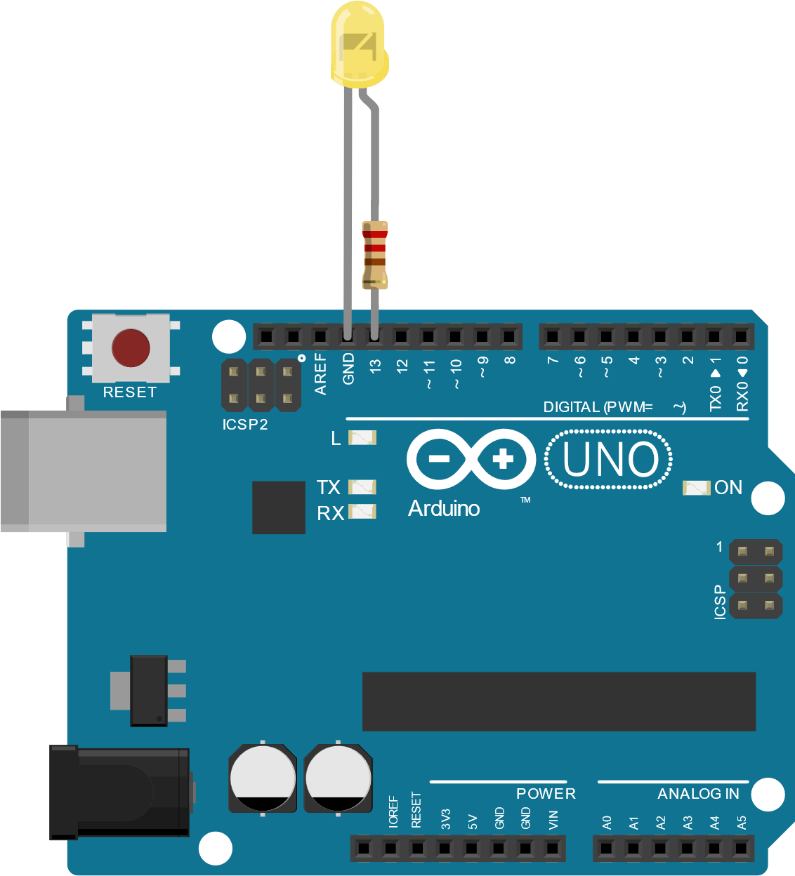
Add an External LED
Provided LED with pre-soldered resistor on Anode (+) side
Connect resistor to 13 and other lead to GND
No need to change the code

Slide 11
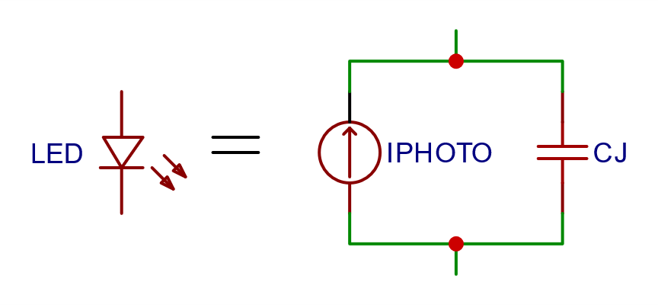
Stuff They Didn’t Tell You About LEDs
LED are photodiodes
Notably Pointed out by Forrest Mims in the 1970’s
LEDs generate photo current when exposed to light
A reverse biased LED has capacitance

Slide 12

About Capacitors
A capacitor is a device which stores charge
Current flowing into a capacitor increases the voltage across it
Charge flowing out of a capacitor decrease the voltage across it
For a reverse biased LED, the photocurrent removes charge from (discharges) the junction capacitance
Current
+
Voltage
-

Slide 13
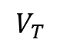
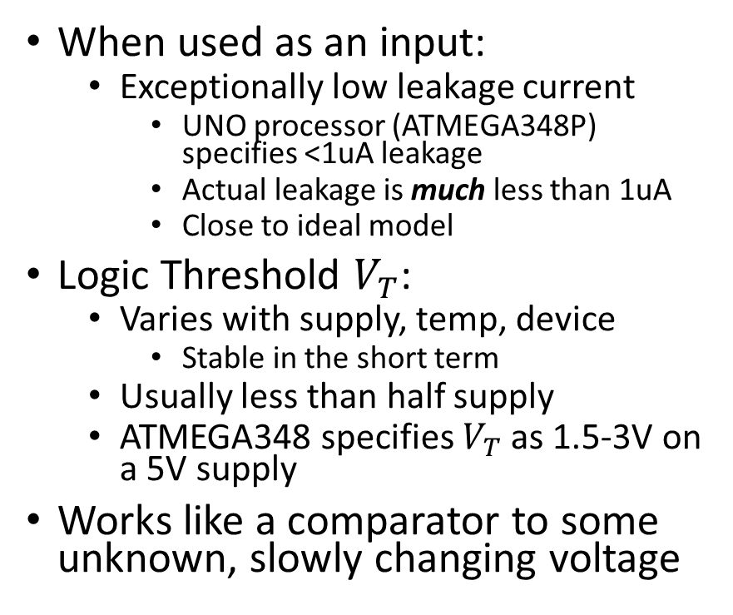
Stuff They Didn’t Tell You About Input Pins
When used as an input:
Exceptionally low leakage current
UNO processor (ATMEGA348P) specifies <1uA leakage
Actual leakage is much less than 1uA
Close to ideal model
Logic Threshold $V_{T}$:
Varies with supply, temp, device
Stable in the short term
Usually less than half supply
ATMEGA348 specifies $V_{T}$as 1.5-3V on a 5V supply
Works like a comparator to some unknown, slowly changing voltage
High
Low
$$V_{T}$$
Vin

Slide 14
In This Section: Sense and Emit Light
Goal: Sense and emit light using capacitance of LED
Make it look simultaneous by switching back and forth quickly
Flicker fusion is around 50Hz
Circuit: Reverse bias the LED using digital pins 3 and 4
Software: three programs:
_02_GraphLight.ino
_03_SenseAndLight .ino
_04_AutoLight.ino
Experiment: Use flashlight to increase light on LED. Observe variations in time to discharge capacitance.

Slide 15
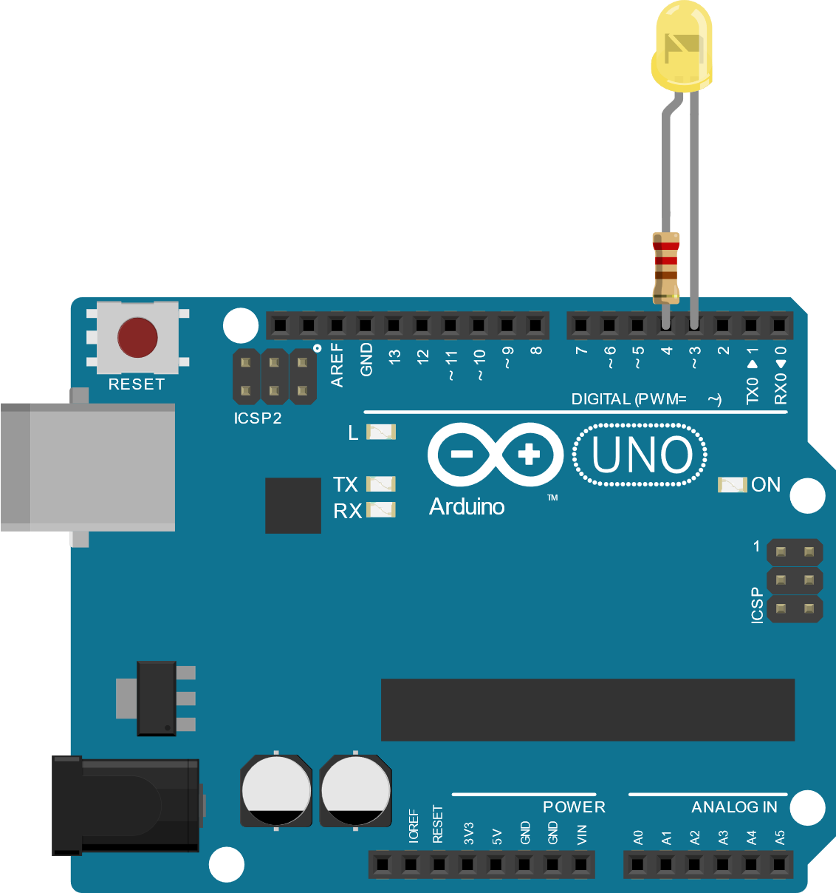
Using the UNO to Measure Light with an LED
Connect LED-resistor across I/O pins 3 and 4 as shown
Reverse bias the LED
This charges the junction capacitance
Change one of the pins to an input
Let the photocurrent discharge the capacitance
Rate depends on light level
See how long it takes before input switches logic level

Slide 16
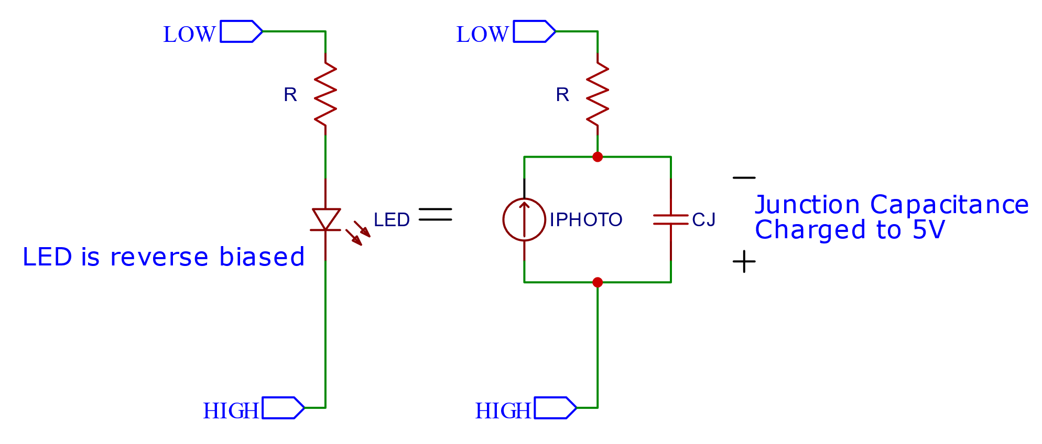
Reverse Bias

Slide 17
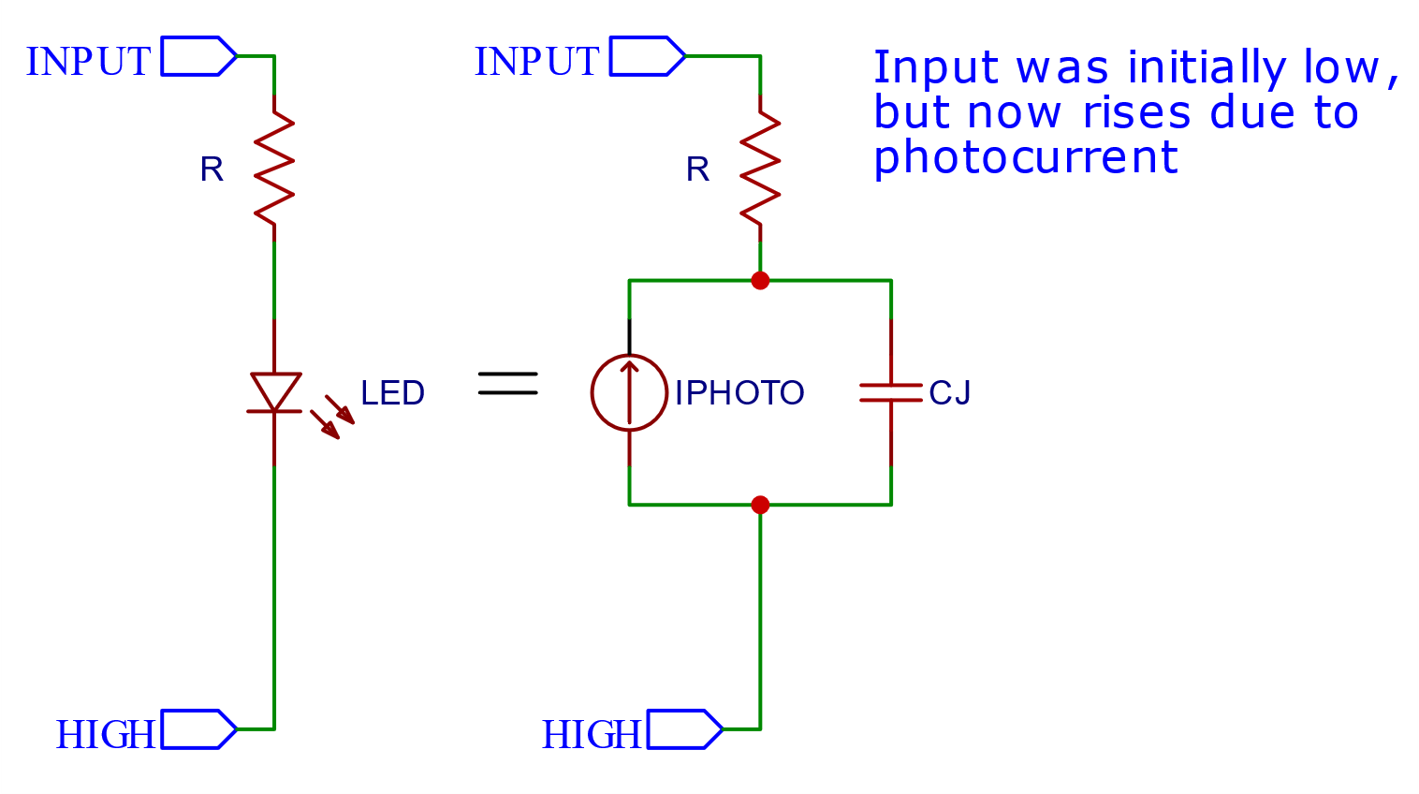
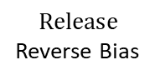
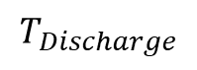
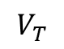
Photocurrent Discharge
Switch from LOW to INPUT
Input
(volts)
Slope depends
on Iphoto – more
Light, more current,
faster discharge
$$V_{T}$$
Time
$$Release$$
Reverse Bias
$$T_{Discharge}$$
Photocurrent causes voltage on input to rise from low to high
(which is discharging the cap because it is decreasing the voltage
across the cap)

Slide 18
Task #2: Graph Light Level Using Serial Plotter
_02_GraphLight.ino
Tools Menu -> Serial Plotter
Set baud rate to 250000
Use flashlight.
Observe in plotter how long it takes for capacitance to discharge

Slide 19
Task #3: Sense Light and Emit Light Loop
_03_SenseAndLight .ino
After discharge timing is done, switch the pins to forward bias the LED
Light for 1ms
Reset back to reverse bias

Slide 20
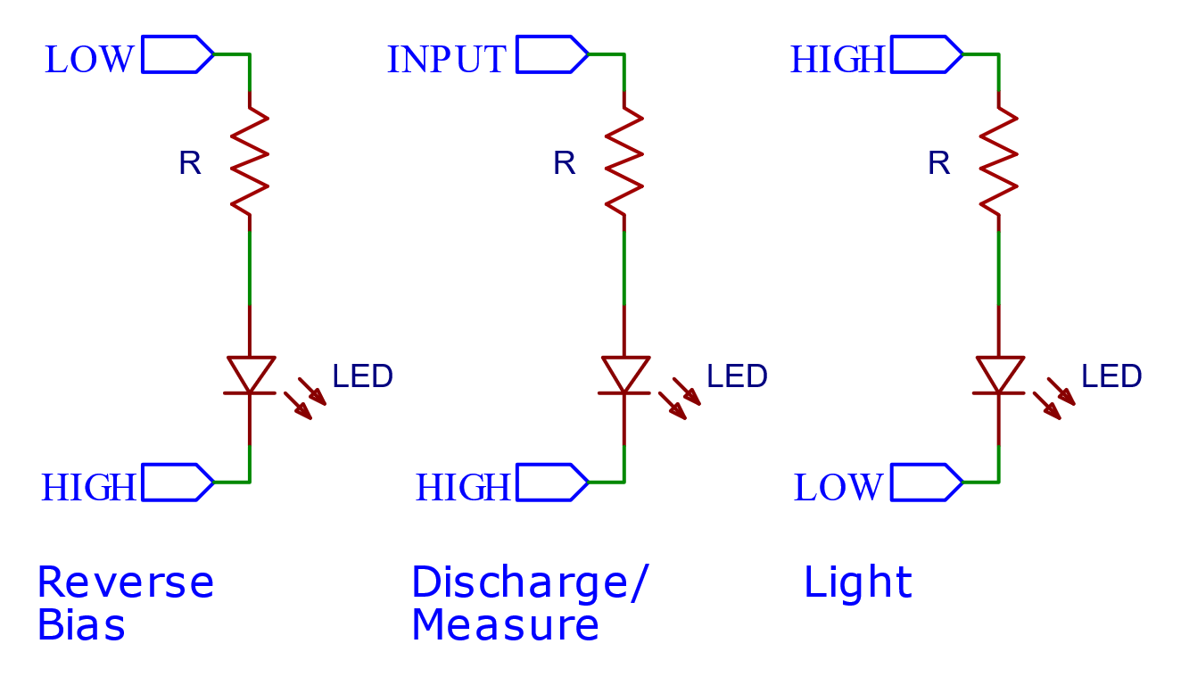
I/O Sequence

Slide 21
Task #4: AutoLight
_04_AutoLight.ino
Reverse bias
Let go
Wait a fixed amount of time
Check once to see if threshold passed
Light LED if dark
Wait a fixed amount of time

Slide 22
In This Section: Sense Temperature and Wind
Goal: To make an LED you can blow out
Circuit: Measure the forward voltage drop of LED using an Arduino analog input
Software: three programs:
_05_GraphHotLED.ino
_06_GraphHotLED256 .ino
_07_BlowOutLED.ino
Experiment: Blow on the LED and observe variations in forward voltage in plotter.

Slide 23
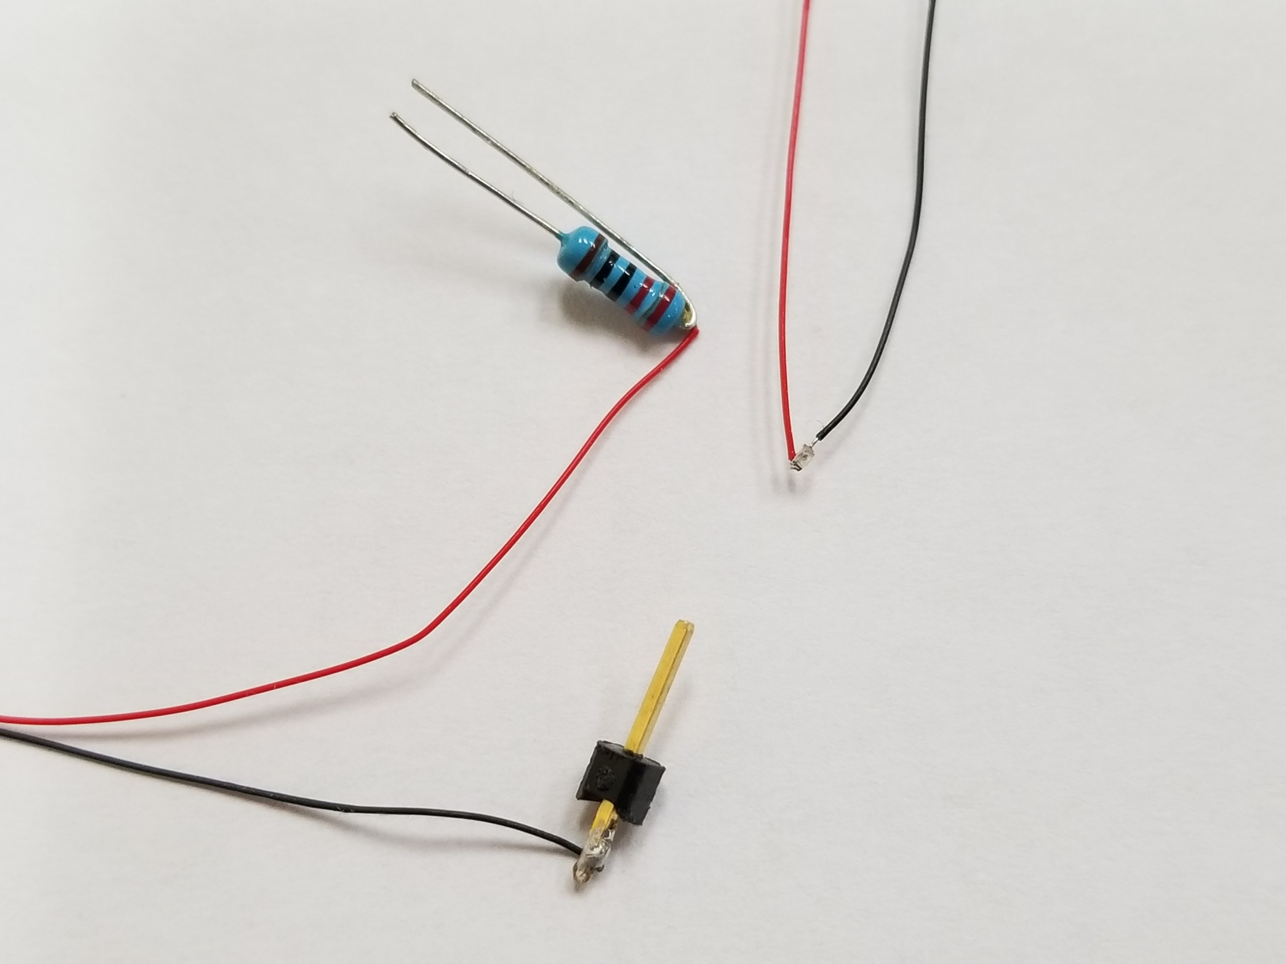
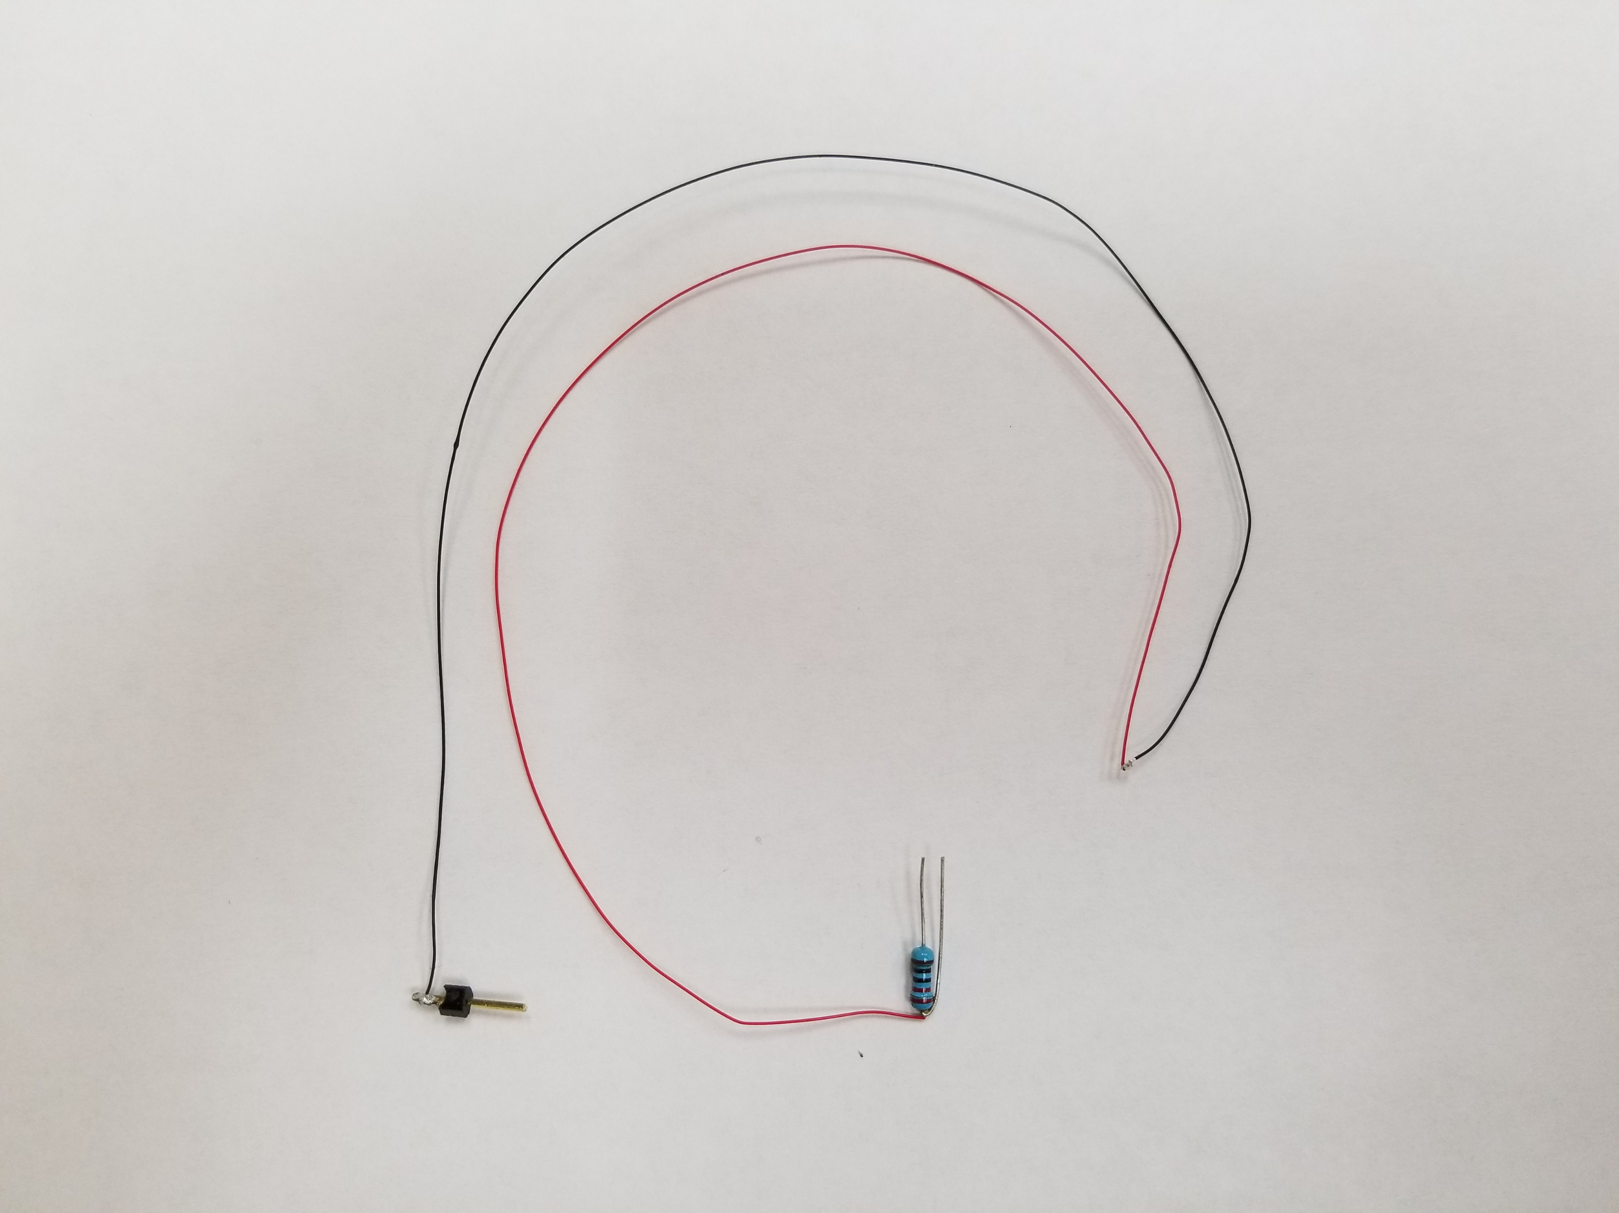
Pre-wired 0402 LED for Fast Thermal Response

Slide 24
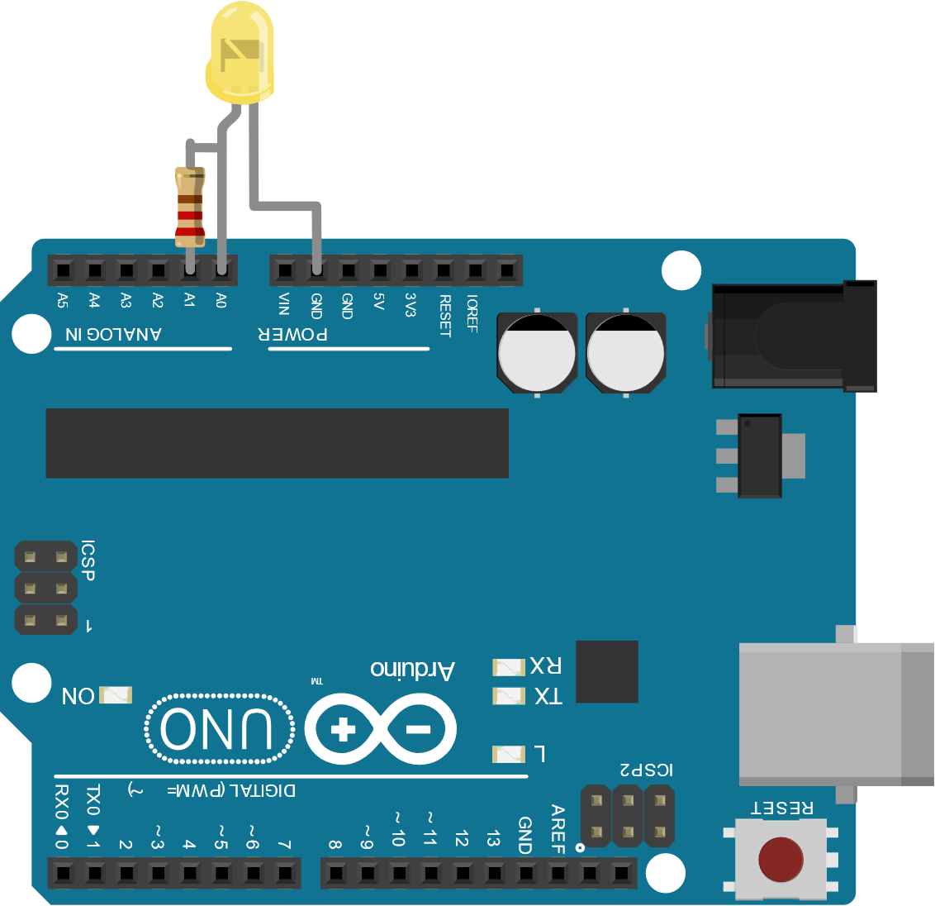
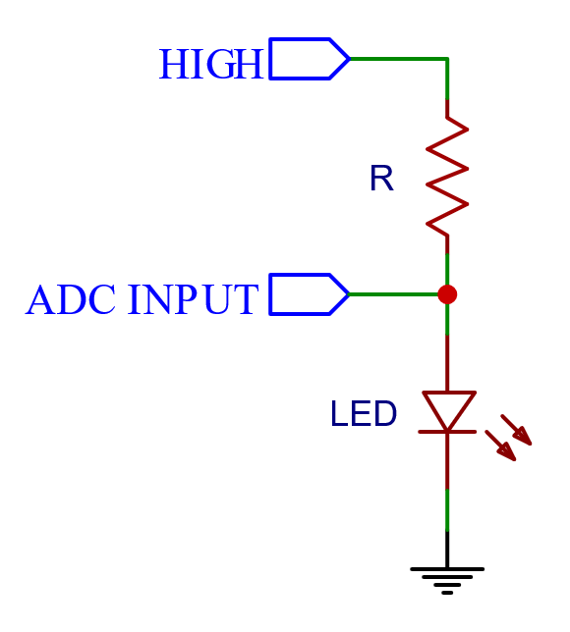

Measuring $V_{f}$

Slide 25
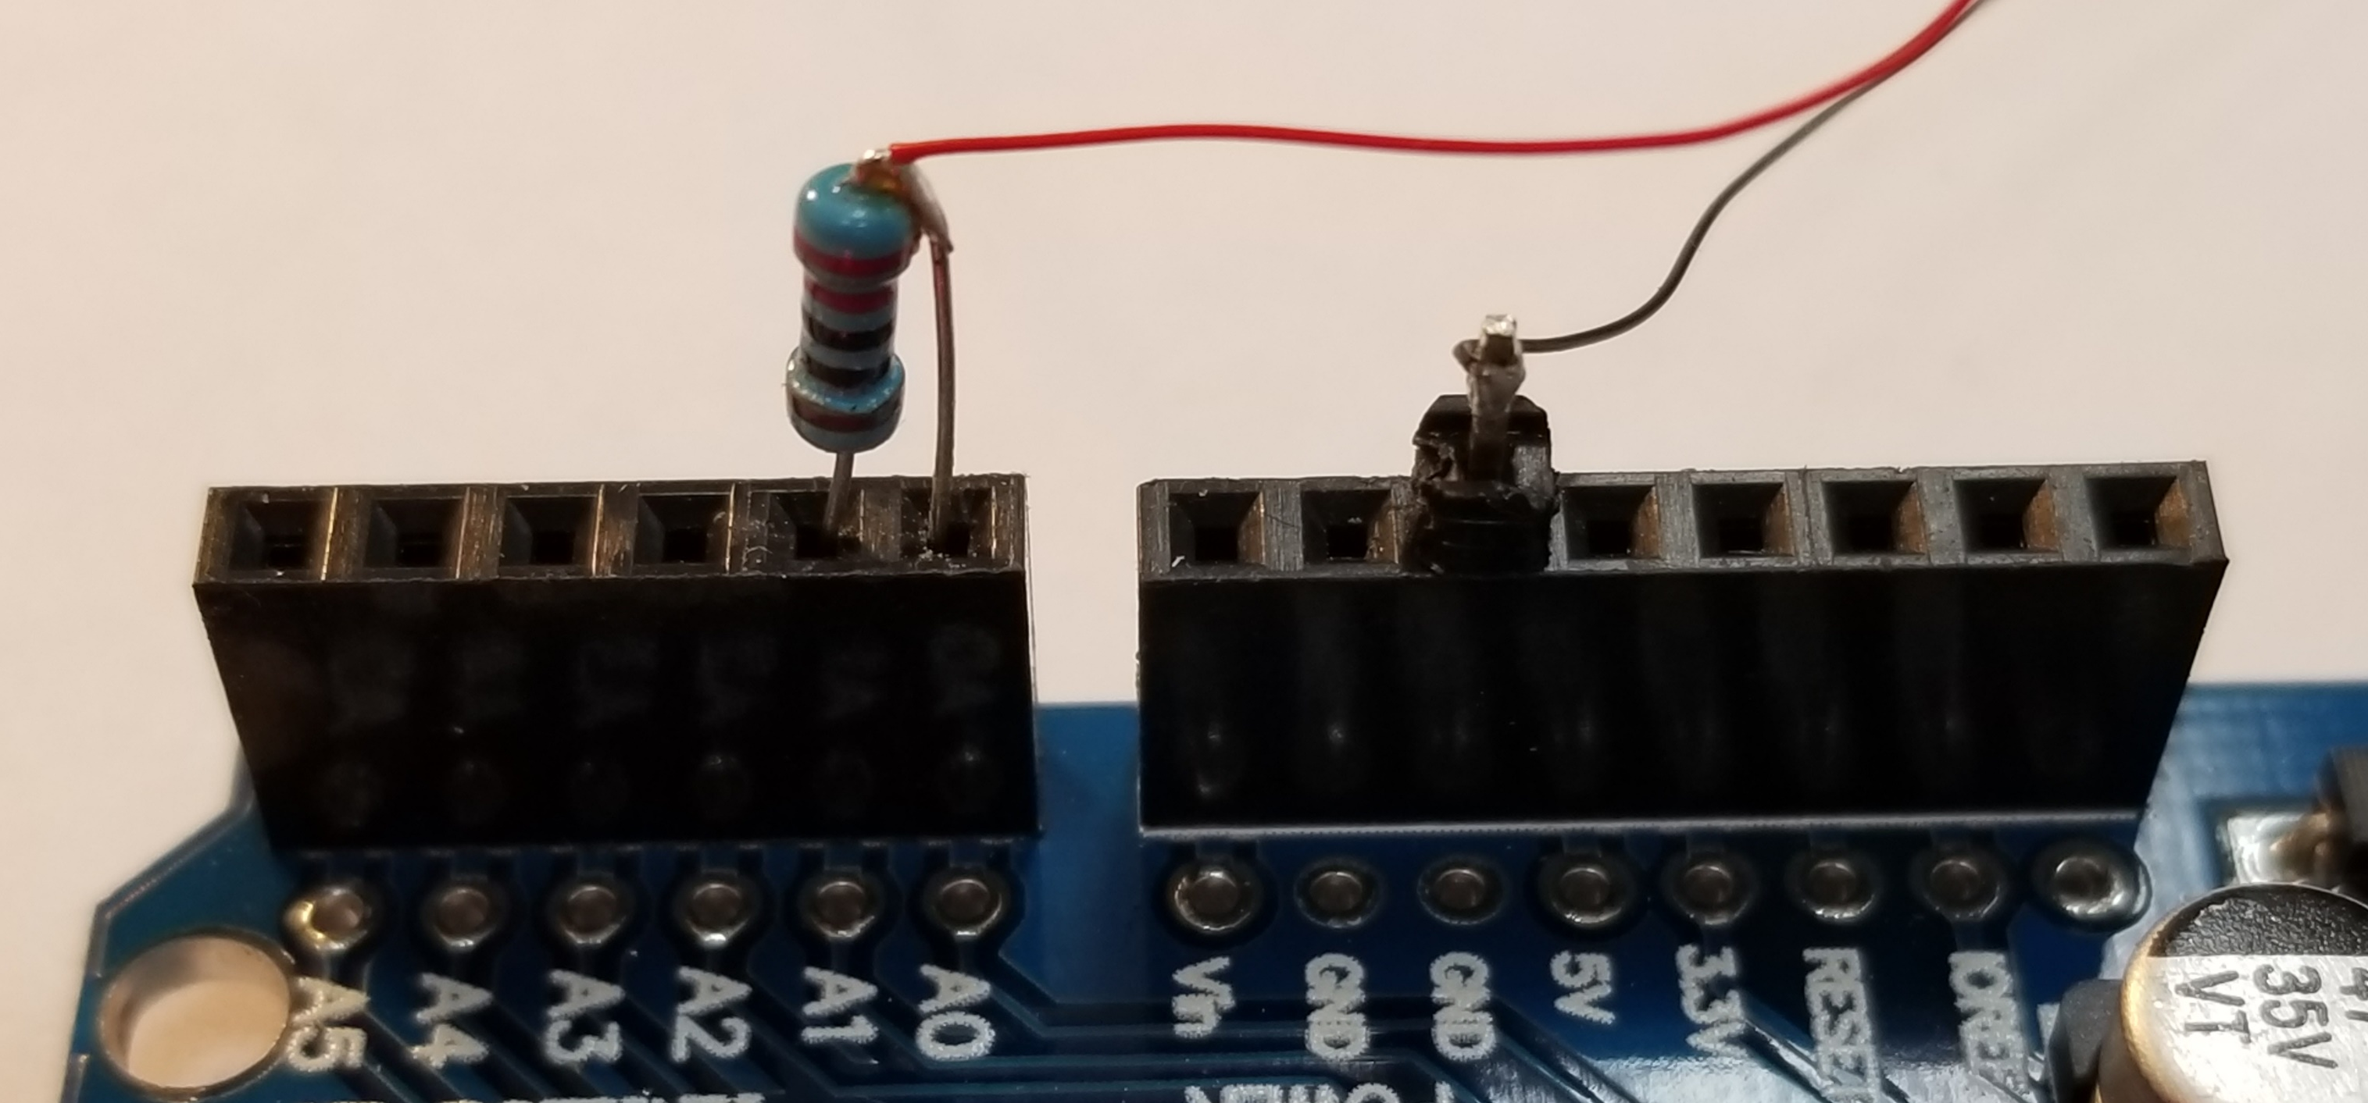
Close-Up of the Wiring

Slide 26
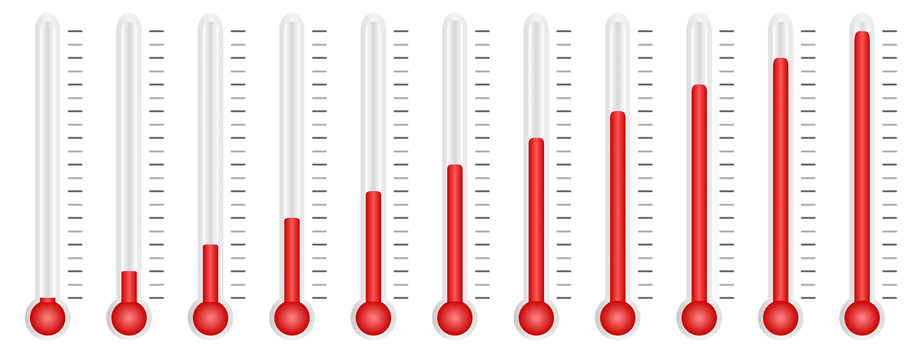
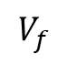
Sensing Temperature with an LED
Forward voltage drop decreases with increasing
temperature
Diodes are frequently used to sense temperature on chip
At a fixed current, forward voltage drop of a silicon diode has a temperature coefficient of ~ -2mv/°C
LEDs are diodes, but use different materials
Forward
Voltage
$$V_{f}$$
Temperature

Slide 27
Forward Voltage Drop vs Temperature
“All LEDs exhibit forward voltage variation as junction temperature changes. The temperature coefficient depends from junction type. InGaAlP LEDs (Yellow and Amber Red) have a coefficient of between -3.0 mV/K to -5.2 mV/K, and the InGaN LEDs (Blue, Verde Green, and White) have a coefficient of between –3.6 mV/K and -5.2 mV/K. (Golden Dragon LWW5SG)”
https://www.onsemi.com/pub/Collateral/TND328-D.PDF

Slide 28
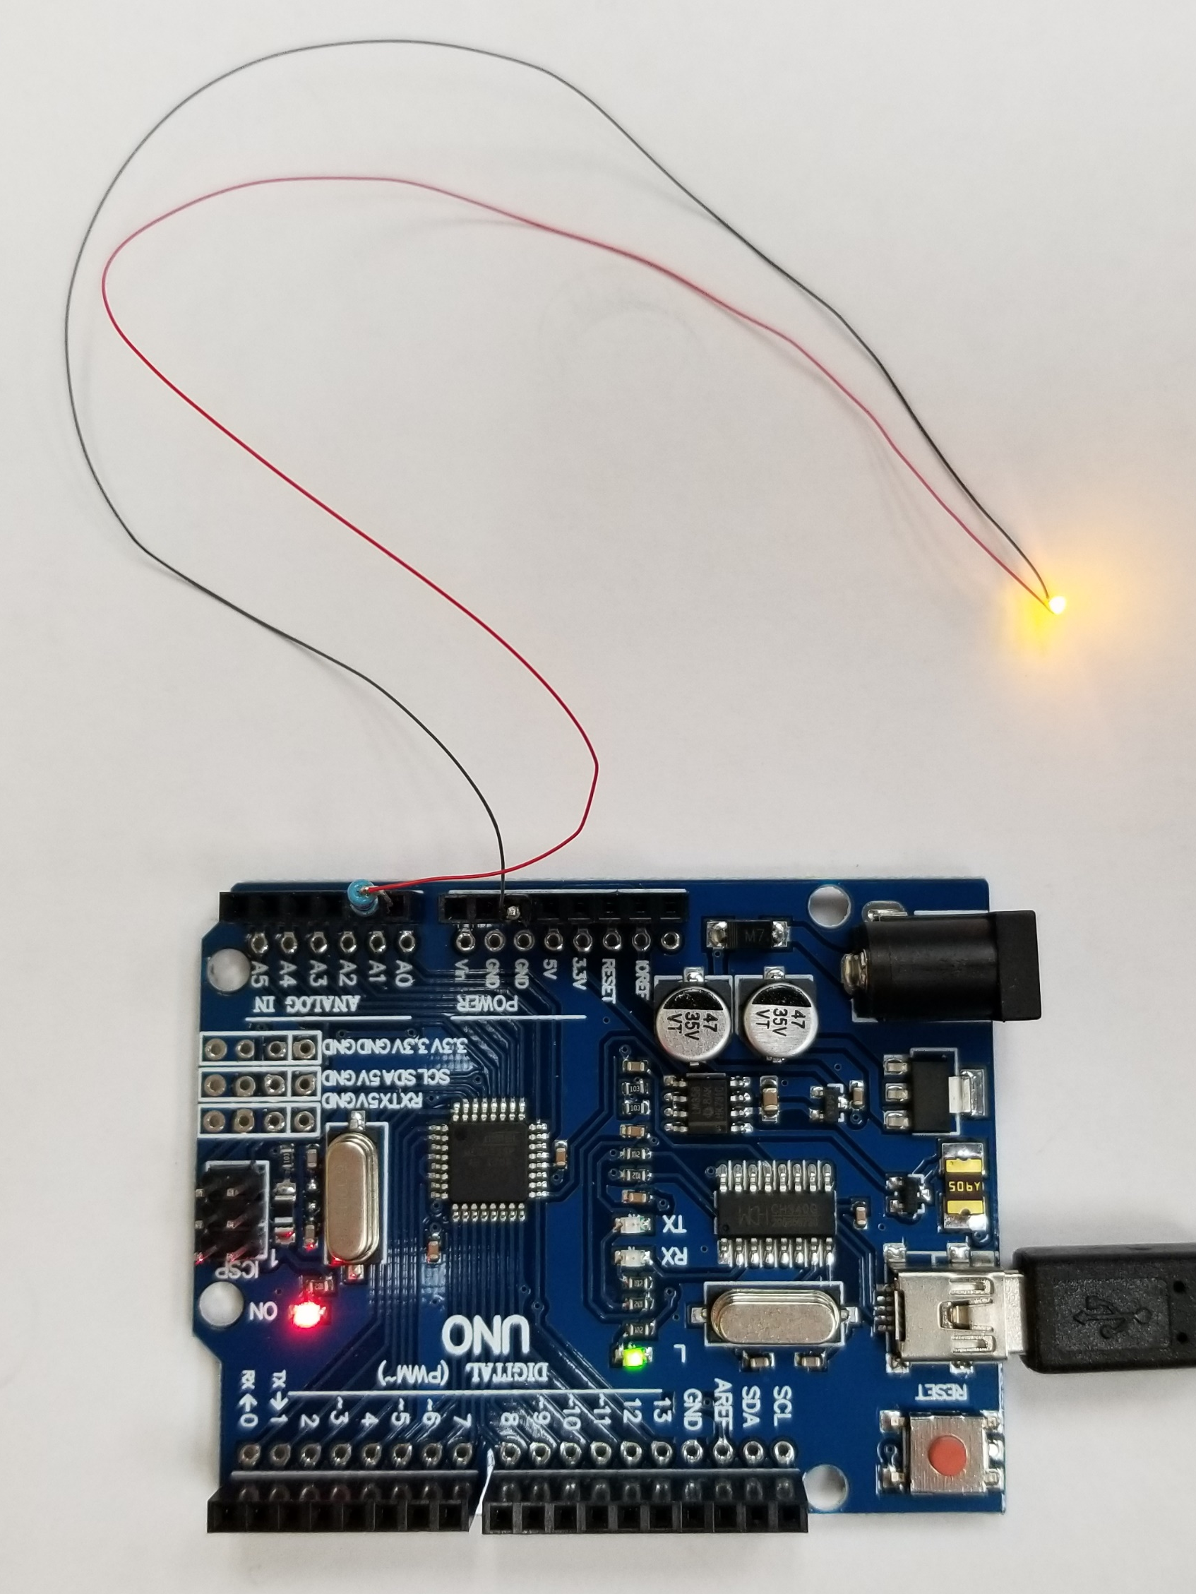
Task #5: Graph Hot LED
_05_GraphHotLED.ino
Turn on the LED
Measure the voltage drop on the LED

Slide 29
Task #6: Graph Hot LED with Averaging
_06_GraphHotLED256.ino
Need to increase the resolution of the measurement
Average across many readings
No need to do the division
Just report the sum

Slide 30
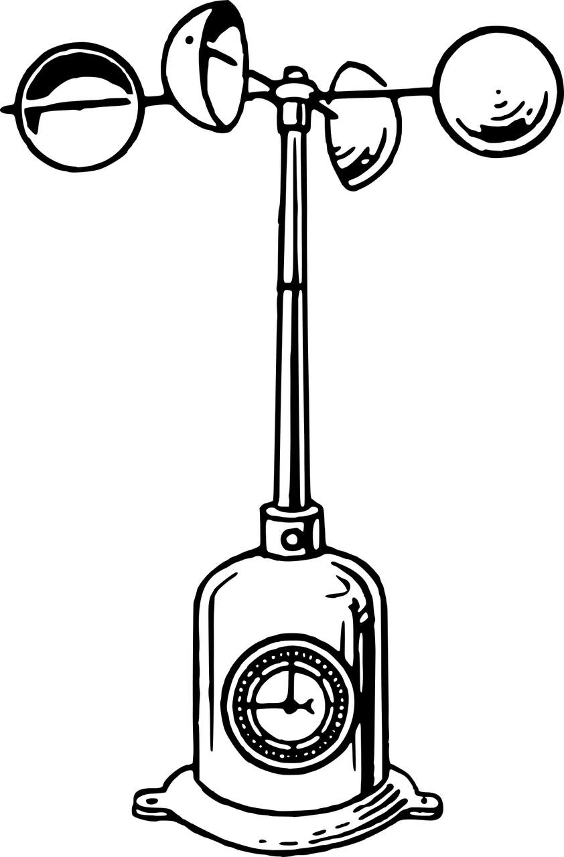
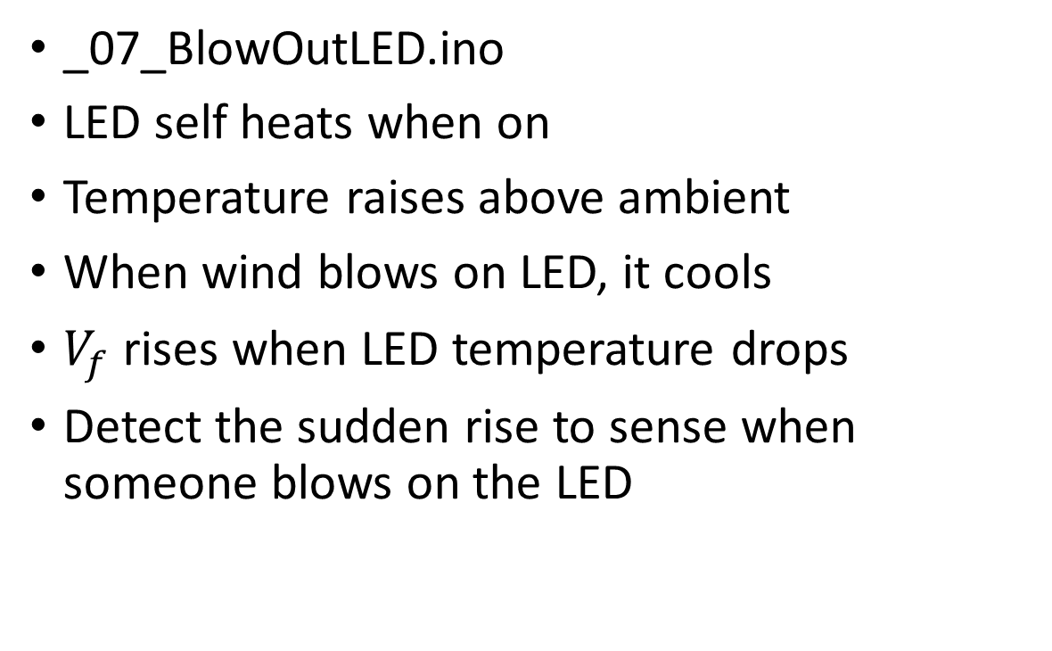
Task #7: A Hot LED Anemometer
_07_BlowOutLED.ino
LED self heats when on
Temperature raises above ambient
When wind blows on LED, it cools
$V_{f}$ rises when LED temperature drops
Detect the sudden rise to sense when someone blows on the LED

Slide 31
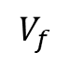
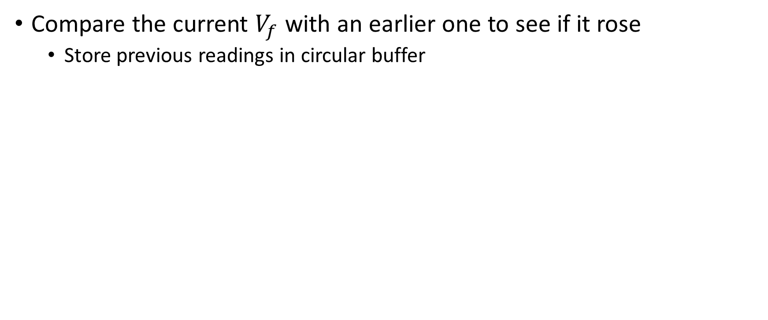
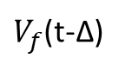
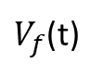
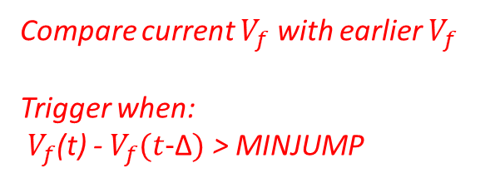
Detecting the Temperature Drop
Compare the current $V_{f}$ with an earlier one to see if it rose
Store previous readings in circular buffer
Forward
Voltage
$V_{f}$(t)
$V_{f}$(t-Δ)
Compare current $V_{f}$ with earlier $V_{f}$
Trigger when:
$V_{f}$(t) - $V_{f}(t\text{−}\text{Δ})$ > MINJUMP
$$V_{f}$$
Δ
Time

Slide 32
LEDs as Interfaces
Talk to a widget’s LED with a phone app
Build interfaces for the disabled
Make expressive musical instruments
Create an electronic birthday cake with candles you can blow out
Output
Human-readable output
Machine-readable output
Input
Measure light levels
Detect human gestures
Receive data from devices
Measure Temperature
Measure ambient temperature
Hot LED Anemometer
Measure wind speed
Detect puffs
Measure wind direction
Use multiple Hot LEDs and baffles
Detect puffs location

Slide 33
Refs and Acknowledgements
Interesting References
Mims, Forrest M., III, Siliconnections: Coming of Age in the Electronic Era, McGraw-Hill, New York, NY, 1986.
Filippo, R.; Taralli, E.; Rajteri, M., “LEDs: Sources and Intrinsically Bandwidth-Limited Detectors”, Sensors, 2017. https://www.ncbi.nlm.nih.gov/pmc/articles/PMC5539727/
Dietz, P.H.; Yerazunis, W.S.; Leigh, D.L., "Very Low-Cost Sensing and Communication Using Bidirectional LEDs", ACM International Conference on Ubiquitous Computing (UbiComp), October 2003. http://www.merl.com/publications/TR2003-35
Jeff Han’s touch LED array: https://mrl.nyu.edu/~jhan/ledtouch/index.html
Scott E. Hudson. 2004. Using light emitting diode arrays as touch-sensitive input and output devices. In Proceedings of the 17th annual ACM symposium on User interface software and technology (UIST '04). ACM, New York, NY, USA, 287-290. DOI: https://doi.org/10.1145/1029632.1029681
Acknowledgements
Rita Kambil – Made up the parts kits for this workshop
James Scott @ Microsoft Research – unpublished work on new LED interfaces

